Slide 1
PROJECT TITLE: AI Powered Legal Documentation Assistant
PIP4004 Capstone Project
Final Review
Batch Number:CSD-G05
ROLL NUMBER | STUDENT NAME
20211CSD0052 | SWARNA LOHIT
20211CSD0050 | SANJAY S
20211CSD0199 | MANOJ M
Under the Supervision of,
Dr./Mr./Ms./Prof. Sandhya L
Professor / Associate Professor / Assistant Professor
School of Computer Science and Engineering
Presidency University
Name of the Program: B-TECH (CSE-DATA SCIENCE)
Name of the HoD: Dr. Saira Banu Atham
Name of the Program Project Coordinator: Prof. Sandhya L
Name of the School Project Coordinators: Dr. Sampath A K / Dr. Abdul Khadar A / Mr. Md Ziaur Rahman

Slide 2
Introduction
The rapid advancement of artificial intelligence (AI) has had a profound impact on various industries, and the legal field is no exception. This research paper examines the implications of AI on legal research and case analysis. The paper explores the evolution of AI technology in the legal domain, its potential benefits, and the challenges it poses to traditional legal research methods. Legal research and case analysis are essential components of the legal process. They require extensive examination of legal precedents, statutes, regulations, and case law to support legal arguments and make informed decisions. Traditionally, legal professionals have invested substantial time and effort in sifting through vast amounts of information to identify relevant sources and extract meaningful insights. Traditional methods of legal research and case analysis involved manual techniques such as visiting law libraries, searching through print resources like case reporters and legal encyclopedias, using legal citators to trace case history, and manually cross-referencing information. Researchers relied on indexes and catalogues to locate relevant legal materials, and their analysis was based on reading and interpreting legal texts. The process was time-consuming, limited in access to resources, prone to incomplete or outdated information, and relied heavily on the researcher’s expertise in navigating legal sources. Manual research in the legal field presents challenges and limitations. It is time-consuming, requiring physical access to libraries and extensive searching through volumes of legal materials. Limited access to comprehensive resources can hinder the depth of research. Navigating vast amounts of information is challenging, leading to potential information overload. The reliance on the researcher’s search methodologies can result in missed or irrelevant information. Incomplete or outdated information and difficulty in identifying relevant precedents can impact research quality. Subjectivity and bias are inherent risks, and updates and tracking changes can be inefficient.

Slide 3
Literature Review
Authors | Publication Year | Method/ Technology | Outcome | Limitations
AI-Powered Legal Documentation Assistant., Authors: Vimala V., Sreenidhi V., Nivedha V. | 2024 | AI-Powered Chatbots & Website Interface | Dynamic website integrating AI technologies to assist clients in navigating complex legal requirements. | Lack of empirical evaluation or user feedback to validate the system's effectiveness and user satisfaction.
Document Automation Architectures: Updated Survey in Light of Large Language Models., | 2023 | Conducted a study with 75 legal professionals, evaluating legal documents. | Perceptions of documents believed to be authored by humans versus those generated by Large Language Models (LLMs). | The study focuses on perceptions rather than actual performance or accuracy of AI-generated documents.
Development of a Legal Document AI-Chatbot., Authors: Pranav Nataraj Devaraj, Rakesh Teja P V, Aaryav Gangrade, Manoj Kumar R | 2023 | Flask & REST API methods. | AI-powered chatbot designed to assist with legal document processing, integrating an Android application | Security measures and data privacy considerations are not extensively discussed, which are critical in legal applications.
Authors
Publication Year
Method/ Technology
Outcome

Slide 4
Existing method Drawback
Bias and Perception Issues: Many legal professionals exhibit bias against AI-generated documents, perceiving them as less reliable or accurate even when their quality is comparable to human-authored documents.
Bias and Perception Issues: Many legal professionals exhibit bias against AI-generated documents, perceiving them as less reliable or accurate even when their quality is comparable to human-authored documents.
Lack of Contextual Understanding: AI models struggle with interpreting complex legal contexts, jurisdictional variations, and nuanced case-specific requirements, leading to potential misinterpretations or oversimplifications.
Ethical and Accountability Concerns: The use of AI in legal documentation raises concerns about authorship, liability, and trustworthiness, as mistakes in legal contracts or filings can have serious consequences.
Data Privacy and Security Risks: Legal documents contain highly sensitive information, and AI-powered systems introduce risks of data leaks, unauthorized access, or compliance challenges with legal privacy regulations.

Slide 5
Objectives
To create an AI-driven legal document assistant that improves the efficiency, accuracy, and accessibility of legal document creation using natural language processing (NLP) and machine learning, while solving some of the major challenges including bias, understanding of context, ethical issues, limitations in customization, and risks of data privacy. The system should help legal experts and clients through automated yet customizable legal document drafting, validation, and compliance verification, maintaining reliability and trustworthiness in AI-created legal content.
Overall, the application of AI in the legal profession sector improves efficiency, accuracy, decision-making, and access to legal information, empowering legal professionals to deliver better outcomes for their clients and enhance the overall practice of law.

Slide 6
Methodology/Modules
Technology Stack Components:
Backend Development: Python (Django) : High-level Python web framework for robust apps
Frameworks: (Lang Chain) : Framework for building language models
Databases: (ChromaDB): Vector database for RAG implementation
API: (OpenAI API) : Powering natural language understanding

Slide 7
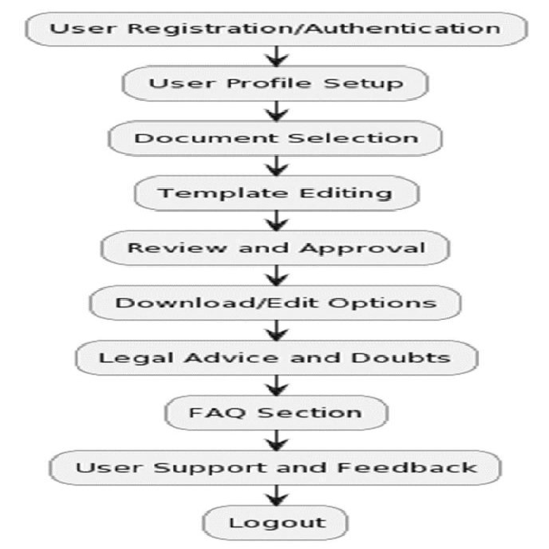
Architecture

Slide 8
Timeline of Project
Review 0
Discuss the Approach of the
Problem Statement &
Identification
Review 2
Developing an AI Powered Legal Assistant
Review 1
Data Collection and Preprocessing
From Sources
0
1
2
3
Final Viva
Voce
Review
Review 3
100% completion of project
With Working Code , and suitable Algorithm and Report
Final Viva-Voce
Live Demonstration of the project and submission of the Publication Paper

Slide 9
Expected Outcomes
AI-driven validation mechanisms will reduce human errors in legal documents, ensuring better compliance with legal standards, avoiding inconsistencies, and improving overall document quality.
By automating repetitive tasks such as document drafting and review, the system will lower operational costs for law firms and clients, making legal services more accessible and affordable.
The integration of AI with a user-friendly interface will allow clients and legal professionals to easily customize documents based on specific needs, improving the overall experience and satisfaction.

Slide 10
Conclusion
The legal documentation assistant powered by AI is a revolutionary change in the legal profession, designed to simplify document creation and increase precision through latest AI and NLP technologies. With an integration of rule-based templates and AI customization, the software will resolve crucial issues such as context comprehension and compliance with laws. Though the technology ensures cost savings and efficiency, it needs human intervention as well to provide assurance on the reliability and authenticity of the documents. Additionally, the application of data privacy and security ensures that legal information that is sensitive in nature is safeguarded. Eventually, this system can transform legal workflows, more easily making legal services accessible, efficient, and accurate.

Slide 11
Github Link
GitHub Link :
https://github.com/swarna-lohitt/Capstone_AI_Assistant

Slide 12
References
Taherei Ghazvinei, P.; Hassanpour Darvishi, H.; Mosavi, A.; Yusof, K.B.W.; Alizamir, M.; Shamshirband, S.; Chau, K.W. Sugarcane growth prediction based on meteorological parameters using extreme learning machine and artificial neural network. Eng. Appl. Comput. Fluid Mech. 2018, 12, 738–749.
A. M. Kamal, M. Shamsudduha, B. Ahmed, S. K. Hassan, M. S. Islam, I. Kelman, and M. Fordham, “Resilience to flash floods in wetland communities of northeastern bangladesh,” International journal of disaster risk reduction, vol. 31, pp. 478-488, 2018.
H. Shafizadeh-Moghadam, R. Valavi, H. Shahabi, K. Chapi, and A. Shirzadi, “Novel forecasting approaches using combination of machine learning and statistical models for flood susceptibility mapping,” Journal o f environmental management, vol. 217, pp. 1-11, 2018.
DEVELOPING A FLOOD FORECASTING SYSTEM WITH MACHINE LEARNING AND APPLYING TO GEOGRAPHIC INFORMATION SYSTEM: DOI: 10.21163/GT_2023.181.01
Andrian, R., Naufal, M.A., Hermanto, B., Junaidi, A., and Lumbanraja, F.R. (2019). k-Nearest Neighbor (k-NN) Classification for Recognition of the Batik Lampung Motifs. Journal of Physics. 1338(2019) 012061. https://doi:10.1088/1742-6596/1338/1/012061

Slide 13

Project work mapping with SDG

Slide 14
Thank You

